Slide 1


Department of Computer Science and Engineering
GE19612 – PROFESSIONAL READINESS FOR INNOVATION, EMPLOYABILITY AND ENTREPRENEURSHIP
FARM FRIEND - SUGGESTIVE APPLICATION FOR FARMERS
Mannuru Shreeya -210701148
Mercy N -210701157
Navneeth Suresh
-210701176
Dr. M.Jagadeesh,
Assistant Professor ( SG)

Slide 2
Problem Statement
The agricultural sector faces significant challenges in achieving sustainable and efficient farming practices due to the reliance on traditional methods and the lack of access to advanced technological tools. Farmers often struggle with imprecise weather forecasts, time-consuming and costly soil analysis, and generalized recommendations that do not cater to specific needs or conditions. Additionally, there is a gap in accessibility to such information, particularly for those in remote or underserved areas. Security concerns also hinder the adoption of digital solutions. These limitations result in suboptimal crop yields, inefficiencies, and environmental degradation. Addressing these issues requires an integrated, user-friendly application that leverages AI, data analytics, and secure communication to provide tailored, real-time insights and recommendations, thus empowering farmers to optimize their practices, increase productivity, and promote sustainability.

Slide 3
Abstract
The project endeavors to develop an integrated mobile based application fueled by advanced AI algorithms and data analytics to revolutionize agricultural practices and bolster crop productivity. The application boasts a user-friendly interface accommodating multiple languages and incorporates a responsive chatbot for seamless interaction. Core functionalities encompass precise weather forecasting, sophisticated soil analysis via image processing, tailored crop recommendations, irrigation optimization strategies, and eco-friendly solutions for natural fertilizers and pest control. Leveraging GPS technology, the app delivers location-specific insights, while stringent security protocols ensure the protection of user data. Motivated by the imperative to empower farmers with cutting-edge technology, this initiative aims to foster sustainable agricultural practices and enhance the resilience of farming communities worldwide. Through this project, we aspire to contribute significantly to the advancement of global food security and environmental sustainability.

Slide 4
Existing System
The existing agricultural system often relies on traditional methods and limited technology, resulting in inefficiencies and challenges for farmers. Weather forecasting may not be precise or timely, leading to crop losses due to unexpected weather events. Soil analysis typically involves manual sampling and laboratory testing, which can be time-consuming and costly. Recommendations for crops, irrigation, fertilizers, and pest control are often generalized and not tailored to specific needs or conditions, leading to suboptimal outcomes. Additionally, access to such information may be limited, particularly for farmers in remote or underserved areas. Overall, the current system lacks the integration of advanced AI algorithms, data analytics, and user-friendly interfaces that could streamline processes and enhance productivity while promoting sustainable practices.

Slide 5
Proposed System
The aim of this project is to develop a comprehensive mobile based application that revolutionizes agricultural practices worldwide. By integrating advanced AI and data analytics, the goal is to empower farmers with accessible tools to enhance productivity, sustainability, and profitability. Key objectives include designing a user-friendly interface accommodating diverse linguistic backgrounds, delivering accurate weather forecasts tailored to specific cultivation needs, employing image processing for personalized soil analysis and crop recommendations, promoting sustainable practices through irrigation optimization and eco-friendly solutions, integrating location tracking for localized insights, and ensuring stringent security measures to protect user data. Through these objectives, the project seeks to equip farmers with the knowledge and tools to optimize farming practices, increase crop yields, and contribute to the advancement and sustainability of the agricultural sector.

Slide 6
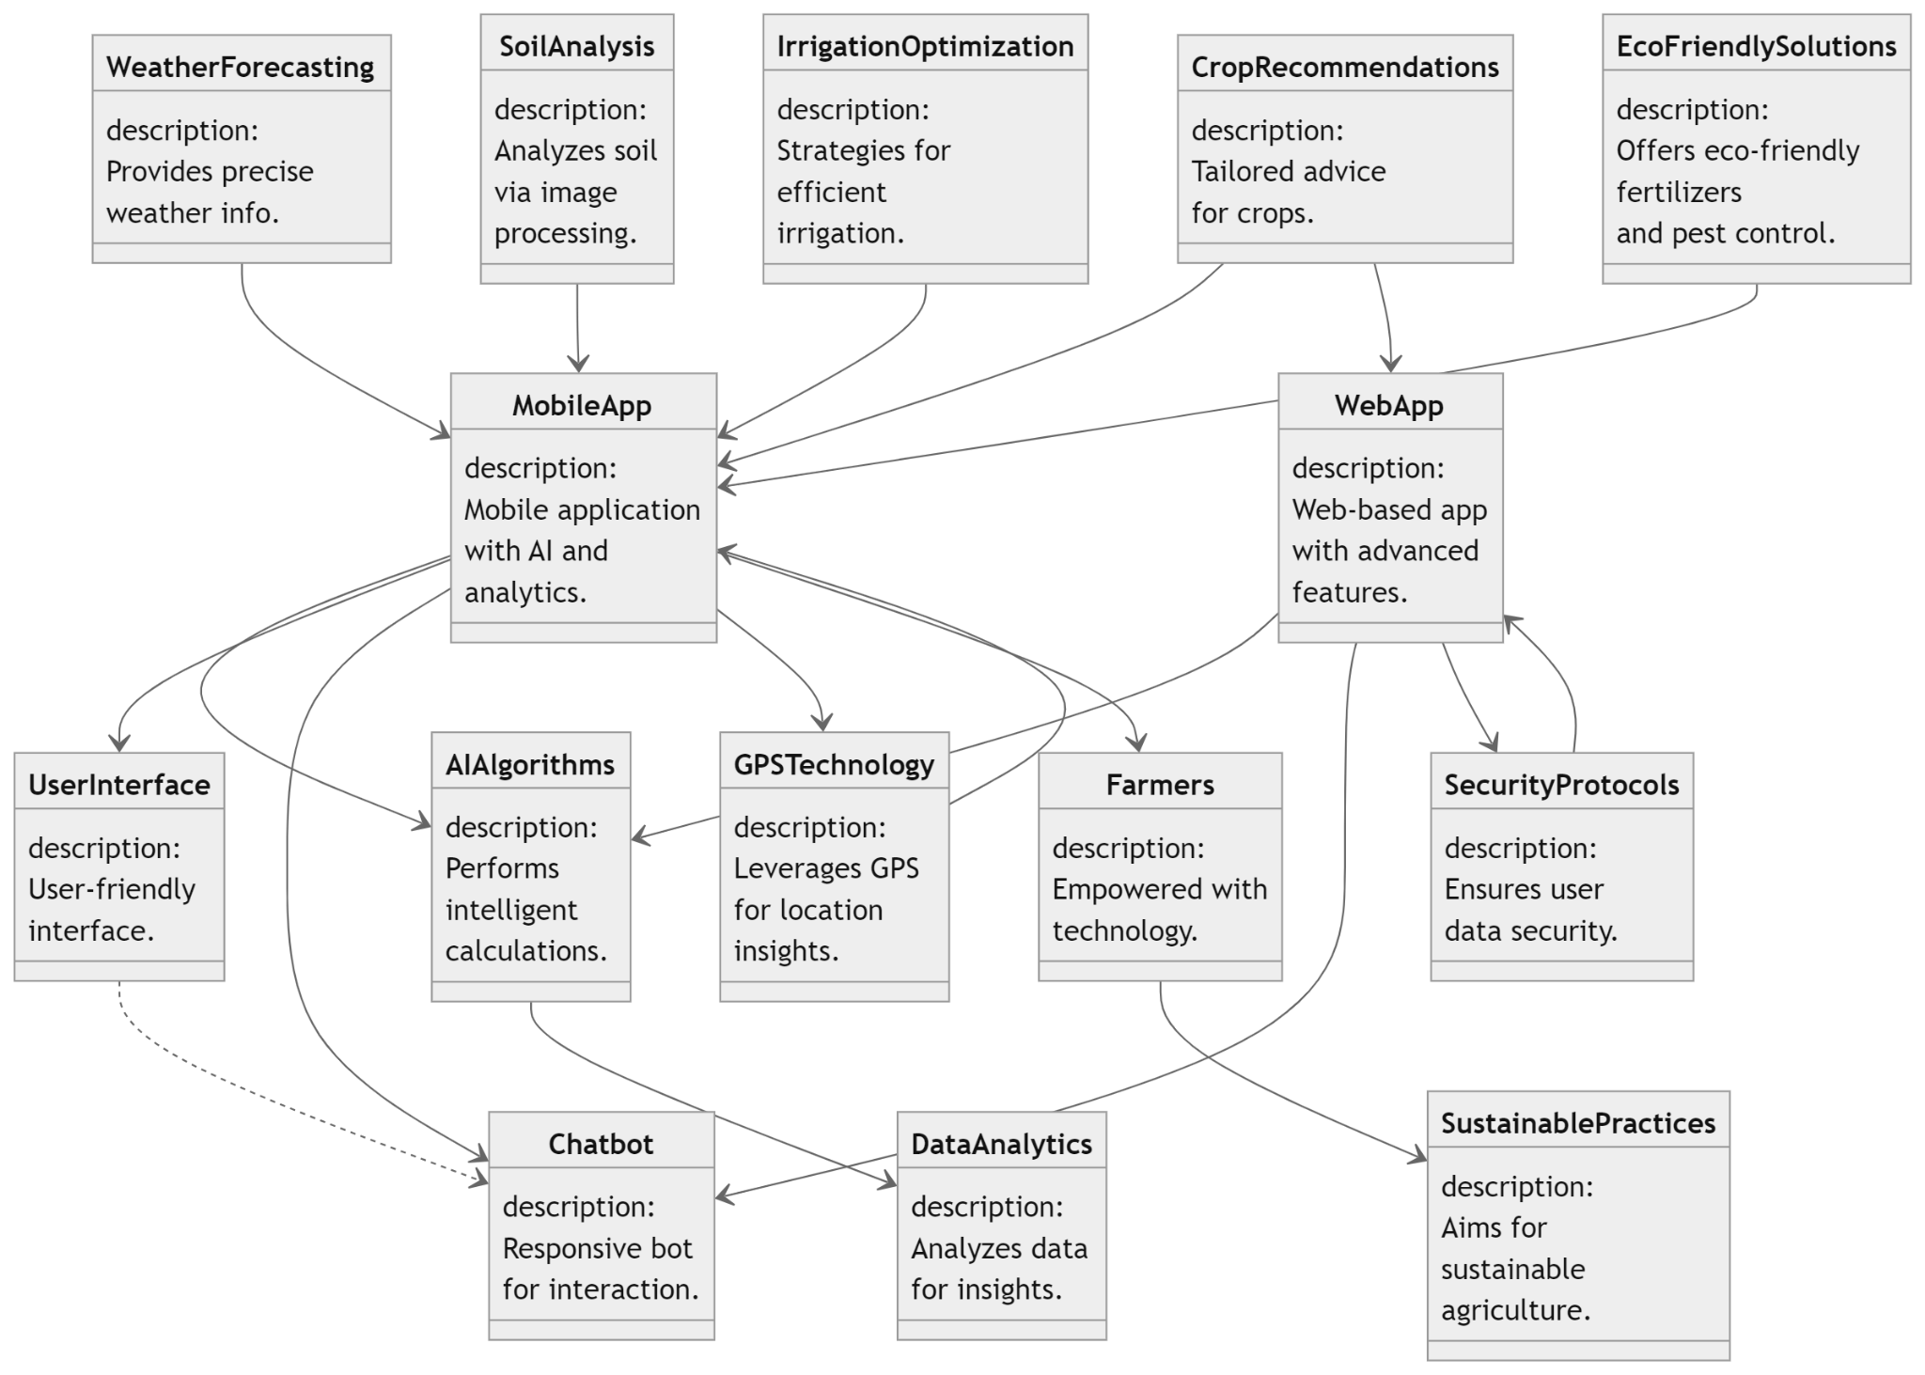
System Architecture

Slide 7
List of Modules
Data Gathering and Preprocessing
Machine Learning Model Development
Integration of Weather Prediction
Accuracy Calculation and Model Evaluation
Additional Features Integration

Slide 8
Functional Description for each modules
Data Gathering and Preprocessing: The first step involves collecting diverse datasets comprising crucial agricultural information. These datasets encompass variables such as soil type, climate conditions, historical crop yields, and real-time weather data sourced from the OpenWeather API. Subsequently, the collected data undergoes rigorous preprocessing to ensure consistency and quality. This preprocessing phase includes cleaning the data to remove any inconsistencies or errors, normalization to standardize the data across different scales, and feature engineering to extract relevant features that will contribute to the effectiveness of the machine learning models.

Slide 9
Functional Description of Module
Machine Learning Model Development: In this phase, the focus shifts towards the implementation of various machine learning algorithms tailored to analyze the agricultural data and provide crop suggestions based on multiple parameters. The implemented algorithms include logistic regression, naive Bayes, SVM, and random forest. Each model is trained using the preprocessed datasets to ensure accurate and personalized crop recommendations, taking into account specific conditions such as soil quality, climate characteristics, and historical crop performance.

Slide 10
Functional Description of Module
Integration of Weather Prediction: To further enhance the accuracy of crop suggestions, real-time weather data from the OpenWeather API is incorporated into the machine learning models. This weather data includes essential parameters such as temperature, precipitation, humidity, and wind speed. By integrating weather data into the models, the app can provide more precise recommendations based on current and forecasted weather conditions, enabling farmers to make informed decisions about crop management strategies.

Slide 11
Functional Description of Module
Accuracy Calculation and Model Evaluation: To ensure the reliability and effectiveness of the machine learning models, accuracy calculation and model evaluation are critical steps. Adaboost and gradient boosting algorithms from the Sklearn library are employed to boost the performance of the base models and improve prediction accuracy. Python libraries such as Seaborn, NumPy, and Pandas are utilized for accuracy calculation, model evaluation, and data visualization, allowing for comprehensive analysis and interpretation of results.

Slide 12
Functional Description of Module
Additional Features Integration: In this phase, additional features are integrated into the app to enhance functionality and user experience. This includes implementing OTP generation for secure user authentication, incorporating multi-language support to cater to farmers from diverse linguistic backgrounds, and developing a chatbot using Flutter to provide real-time assistance and valuable agricultural information through natural language interactions.

Slide 13
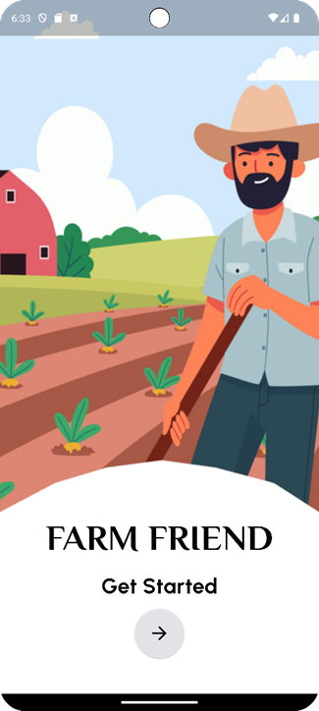
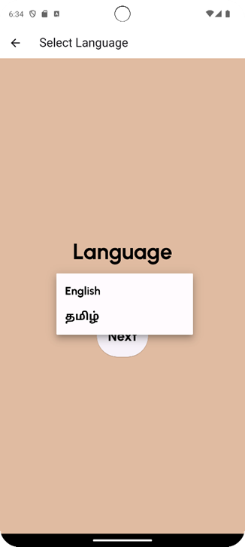

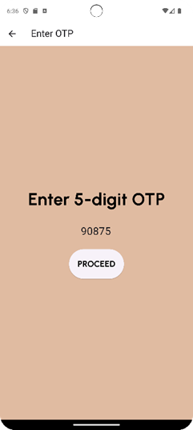
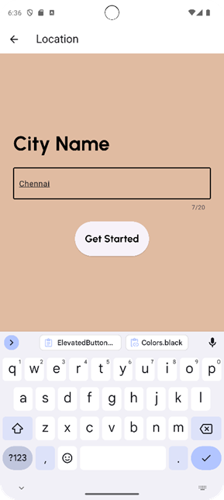
Implementation

Slide 14
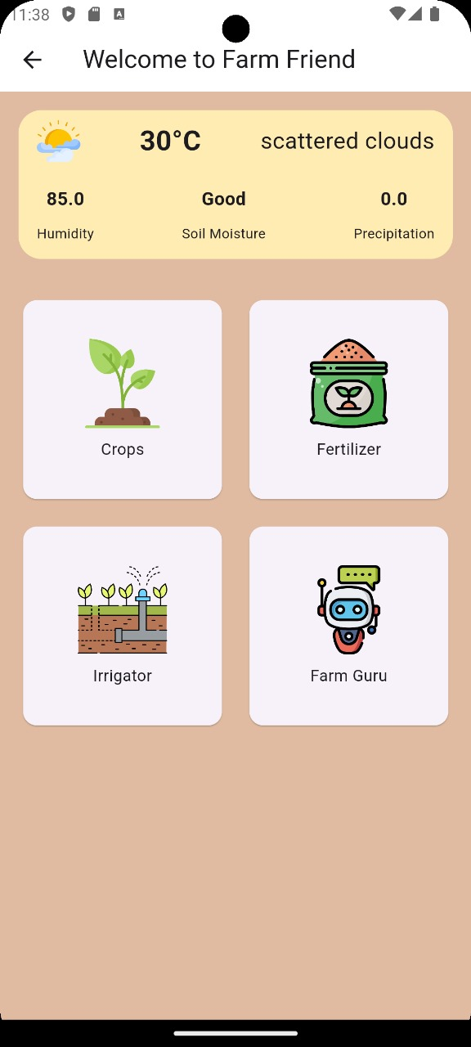
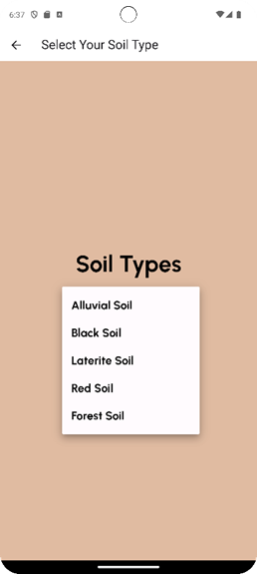
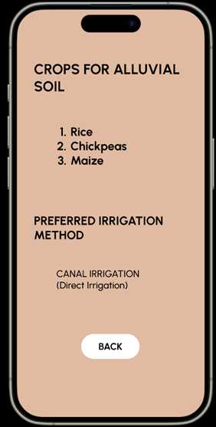

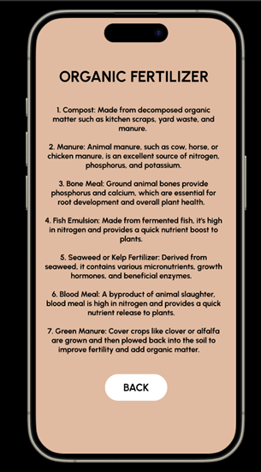
Implementation

Slide 15
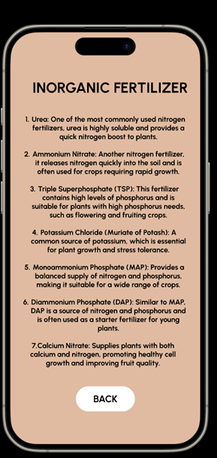
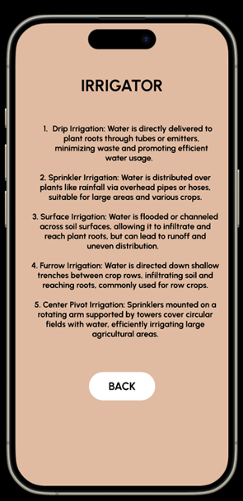
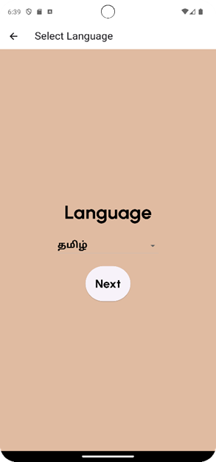
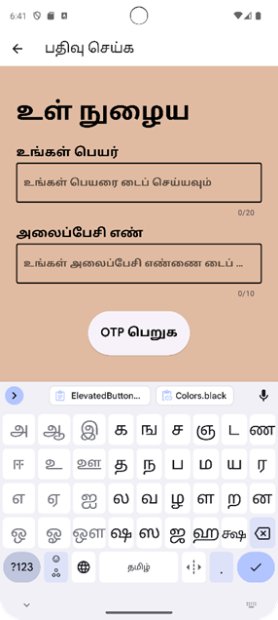
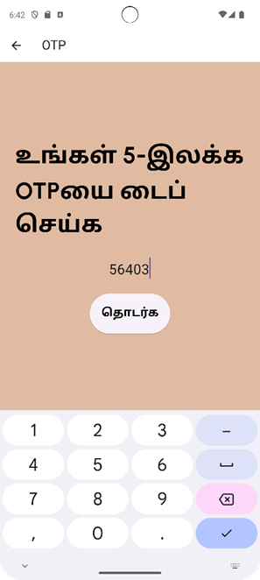
Implementation

Slide 16
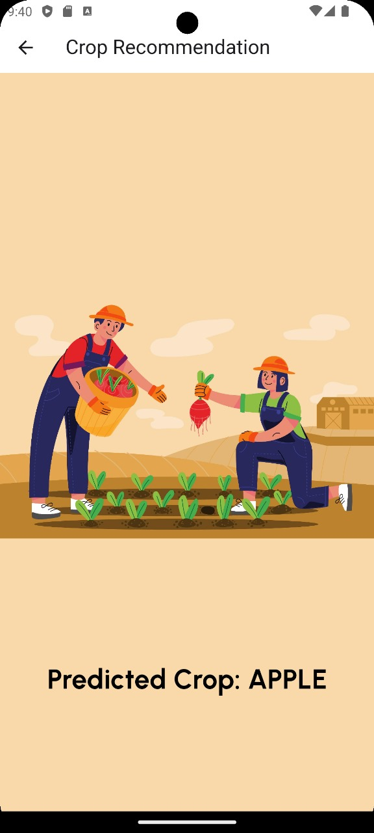
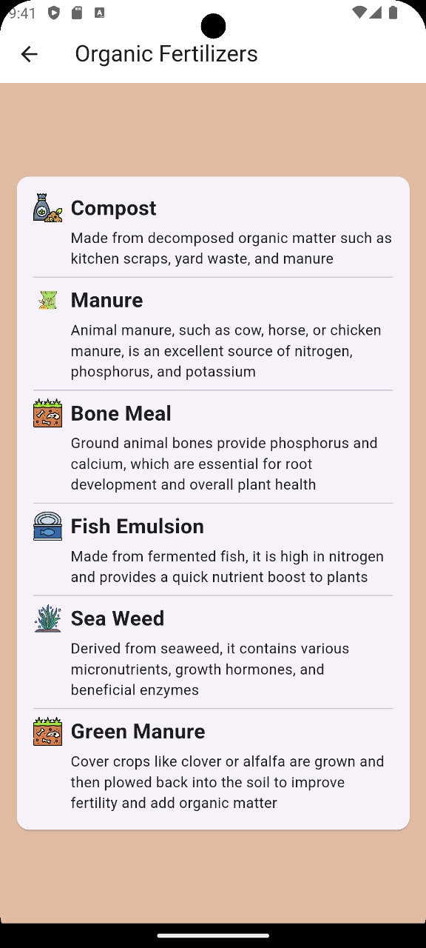
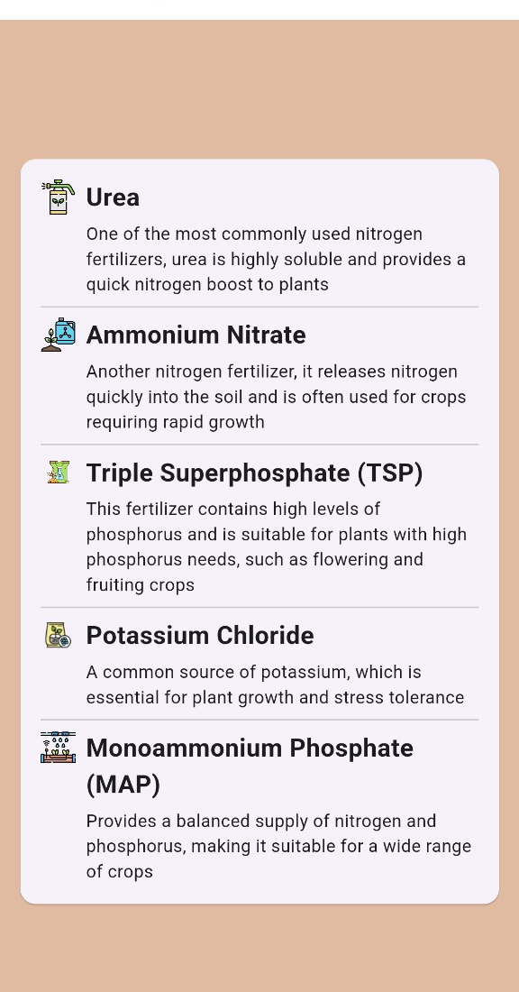
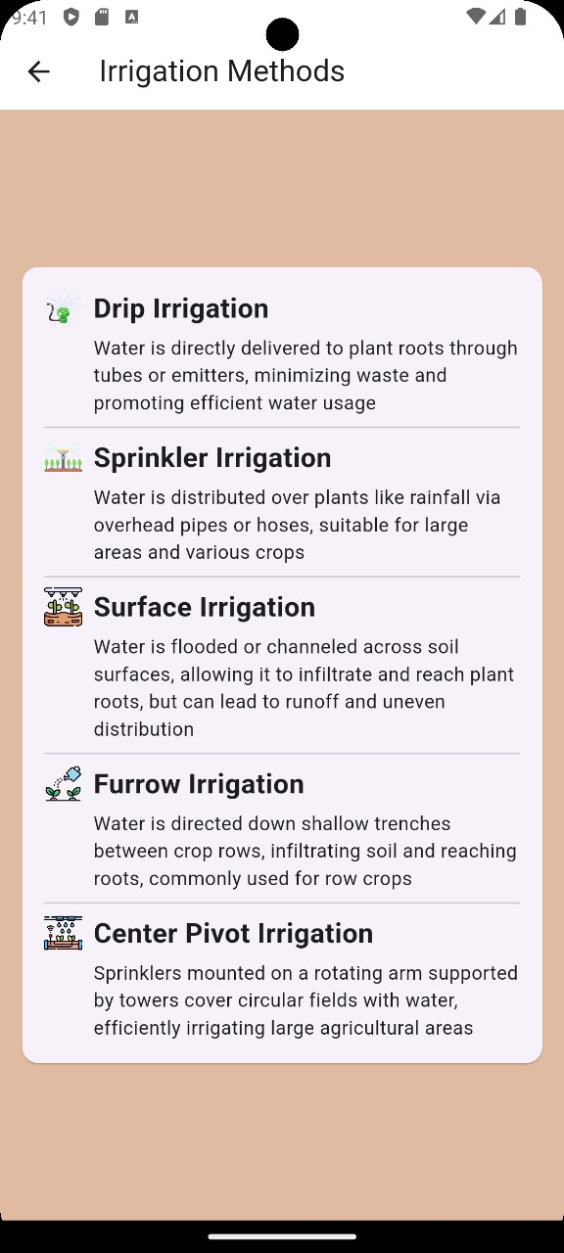
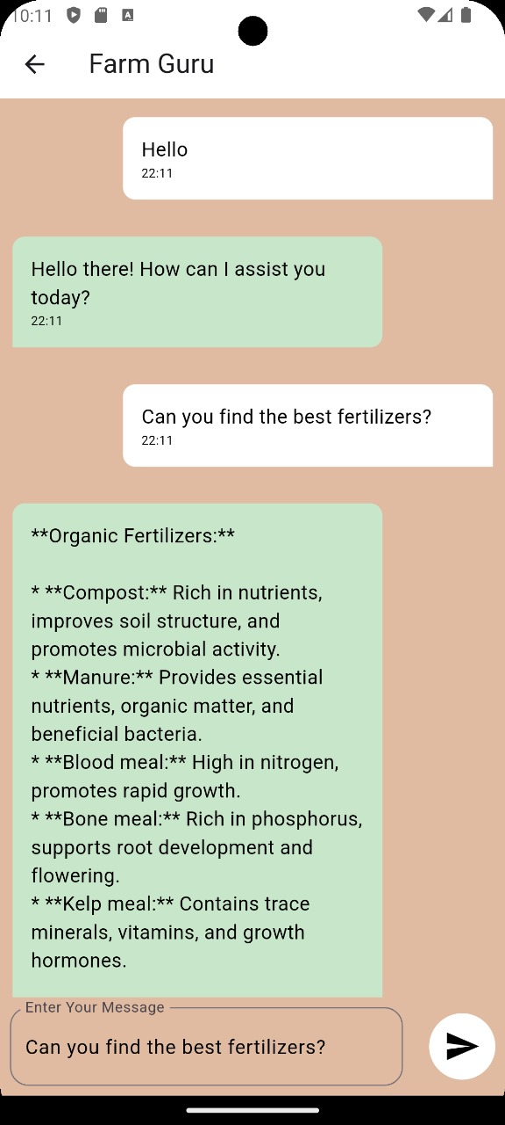
Implementation

Slide 17
Conclusion
In conclusion, the AI-assisted farm app signifies a transformative leap forward in agricultural technology, offering farmers an invaluable resource for optimizing crop selection and cultivation practices. With notable accuracy rates achieved by algorithms such as Naive Bayes, Random Forest, and Decision Tree, the app demonstrates its efficacy in providing reliable crop recommendations. Despite encountering lower accuracies with algorithms like AdaBoost and Extra Trees, ongoing refinement efforts hold promise for augmenting the app's predictive capabilities. Overall, the app stands as a pivotal tool for farmers, delivering real-time weather forecasts, personalized crop suggestions, and accessible features such as multi-language support and chatbot assistance. By harnessing the power of machine learning and data analytics, the app empowers farmers to make informed decisions, enhance agricultural productivity, and foster sustainable farming practices. As it continues to evolve and adapt to the needs of farmers, the app holds immense potential to revolutionize the agricultural landscape, driving efficiency, resilience, and prosperity within the farming community.

Slide 18
References
1. Ghasemi-Varnamkhasti, M., & Feizollahi, M. (2015). A Survey on Agricultural Decision Support Systems: Issues and Challenges. International Journal of Agricultural Management and Development, 5(4), 307-314.
2. Mondal, T., & Soni, V. K. (2020). Artificial Intelligence in Agriculture: Opportunities and Challenges. Journal of Agricultural Informatics, 11(3), 1-17.
3. Sangeetha, S., & Kalaiselvi, K. (2019). Development of a Mobile Application for Agricultural Information System. International Journal of Advanced Research in Computer and Communication Engineering, 8(7), 2871-2875.
4. Al Tarabsheh, A., & Alwada’n, T. (2020). A Comprehensive Review of IoT Applications in Agriculture. International Journal of Engineering Research and Technology, 13(6), 1120-1130.

Slide 19
References
5. Kallumadi, S. T., Vepakomma, P., & Veeravalli, B. (2021). Advancements in Mobile Sensing for Agriculture: A Review. IEEE Sensors Journal, 21(6), 6658- 6673. 6. Al-Tamimi, N., Aloul, F., & Alshawi, M. (2019). Use of Artificial Intelligence in Agriculture: A Systematic Review. Journal of Big Data, 6(1), 1-28.
7. Singh, S., Dubey, M., & Tomar, S. (2020). Mobile Application for Weather Forecasting in Agriculture. Journal of Environmental Science, Computer Science and Engineering & Technology, 9(4), 443-450.
8. Wyche, S., Donner, J., & Ho, M. (2016). A Review of Mobile Applications for Agriculture in Developing Countries. Journal of Information Technology for Development, 22(4), 531-540.

Slide 20
References
9. Shang, R. A., & Zhang, Q. (2019). Recent Advances in Artificial Intelligence for Agriculture. Computers and Electronics in Agriculture, 161, 272-289.
10. Shiferaw, A. D., Zeleke, K. T., & Zewdu, W. T. (2018). Mobile Apps for Agriculture and Rural Development: A Systematic Review. International Journal of Computer Applications, 181(40), 30-37.

Slide 21
Thank You

